Slide 1
Data Analytics
Comp 624
Daw Pwint Phyu Khine

Slide 2
Big Data
Big data is typically broken down by three characteristics:
✓ Volume: How much data
✓ Velocity: How fast that data is processed
- batch
- real time
- near real time
- streaming
✓ Variety: The various types of data
- structured, unstructured (semi-structure)
<<<Veracity>>>,
<<<Value>>>

Slide 3
Data
Data in motion
Data At rest
Data in motion would be used if a company is able to analyze the quality of its products during the manufacturing process to avoid costly errors.
Data at rest would be used by a business analyst to better understand customers’ current buying patterns based on all aspects of the customer relationship, including sales, social media data, and customer service interactions.

Slide 4
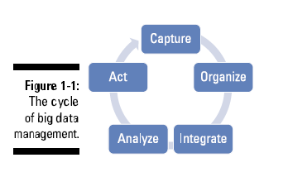
Big Data Management Cycle
It is necessary to identify the right amount and types of data that can be analyzed to impact business outcomes.
Big data incorporates all data, including structured data and unstructured data from e-mail, social media, text streams, and more.

Slide 5
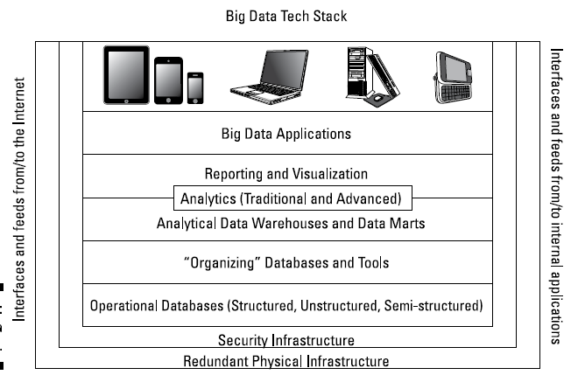
Big Data Architecture
Notes:
Your data architecture also needs to perform in concert with your organization’s
supporting infrastructure.

Slide 6
How Data are generated or captured
Two factors are new in the big data world:
✓ Some sources of big data are actually new like the data generated from sensors, smartphone, and tablets.
✓ Previously produced data hadn’t been captured or stored and analyzed in a usable way.

Slide 7
Understanding Data
Different Types of Data
Structured Data - Traditional types of data
Unstructured Data – Image, Voice, Audio, Video
Semi-structured Data – Time series, Temporal, Spatial

Slide 8
Structured Data
The sources of structured data are divided into two categories:
✓ Computer- or machine-generated: Machine-generated data generally refers to data that is created by a machine without human intervention.
Sensor Data -radio frequency ID (RFID) tags, smart meters, medical devices, and Global Positioning System (GPS) data
Web log Data
Point of Sale
Financial Data
✓ Human-generated: This is data that humans, in interaction with computers, supply.
Input Data e.g. name, age, non-free-form response
Click-stream data
Gaming data
Notes:
Some experts argue that a third category exists that is a hybrid between machine and human.
Input data: This is any piece of data that a human might input into a
computer, such as name, age, income, non-free-form survey responses,
and so on. This data can be useful to understand basic customer
behavior.
✓ Click-stream data: Data is generated every time you click a link on a
website. This data can be analyzed to determine customer behavior and
buying patterns.
✓ Gaming-related dat

Slide 9
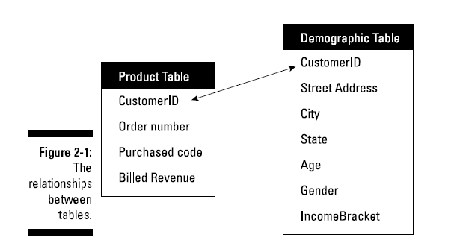
Relational (Structured Data)
In a relational model, the data is stored in a table.
This database would contain a schema — that is, a structural representation of what is in the database.
For example, in a relational database, the schema defines the tables, the fields in the tables, and the relationships between the two.
The data is stored in columns, one each for each specific attribute.
The data is also stored in the rows.
Schema
Relationship
SQL(Structured Query Language)
Notes:
In a relational model, the data is stored in a table. This database would contain a schema — that is, a structural representation of what is in the database.
For example, in a relational database, the schema defines the tables, the fields in the tables, and the relationships between the two. The data
is stored in columns, one each for each specific attribute. The data is also stored in the rows.

Slide 10
Unstructured Data
Unstructured data is data that does not follow a specified format.
If 20 percent of the data available to enterprises is structured data, the other 80 percent is unstructured.
Unstructured data is really most of the data that you will encounter.

Slide 11
Sources of Unstructured Data
Machine-generated unstructured data
Satellite Data: weather data or the data that the government captures in its satellite surveillance imagery e.g. Google earth.
Scientific data: This includes seismic imagery, atmospheric data, and high energy physics.
Photographs and video: This includes security, surveillance, and traffic video.
Radar or sonar data: This includes vehicular, meteorological, and oceanographic seismic profiles.
Human-generated unstructured data:
✓ Text internal to your company: Think of all the text within documents, logs, survey results, and e-mails.
✓ Social media data: Generated from the social media platforms such as YouTube, Facebook, Twitter, LinkedIn, and Flickr.
✓ Mobile data: This includes data such as text messages and location information.
✓ Website content: This comes from any site delivering unstructured content, like YouTube, Flickr, or Instagram.
Notes:
Some people believe that the term unstructured data is misleading because each document may contain its own specific structure or formatting based on the software that created it. However, what is internal to the document is truly unstructured.
E.g. Text Analytics

Slide 12
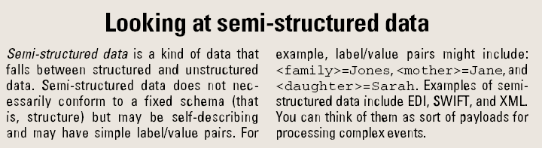
Semi-structured Data

Slide 13
Looking at Real-Time and Non-Real-Time Requirements
Big data approaches will help keep things in balance so we don’t go over the edge as the volume, variety, and velocity of data changes
In general, this real-time approach is most relevant when the answer to a problem is time sensitive and business critical.
This may be related to a threat to something important like detecting the performance of hospital equipment or anticipating a potential intrusion risk.
Sometimes streaming data is coming in really fast and does not include a wide variety of sources, sometimes a wide variety exists, and sometimes it is a combination of the two.
Notes:
The question you need to ask yourself if you’re moving to real time is this:
Could this (problem) be solved with traditional information management capabilities or do we need newer capabilities?
Is the sheer volume or velocity going to overwhelm our systems?
Oftentimes it is a combination of the two.

Slide 14
Considering the Real time
Regarding a system’s capability to ingest data, process it, and analyze it in real time:
✓ Low latency: Latency is the amount of time lag that enables a service to execute in an environment.
Some applications require less latency, which means that they need to respond in real time.
A real-time stream is going to require low latency.
So you need to be thinking about compute power as well as network constraints.
✓ Scalability: Scalability is the capability to sustain a certain level of performance even under increasing loads.
✓ Versatility: The system must support both structured and unstructured data streams.
✓ Native format: Use the data in its native form. Transformation takes time and money.
The capability to use the idea of processing complex interactions in the data that trigger events may be transformational.

Slide 15
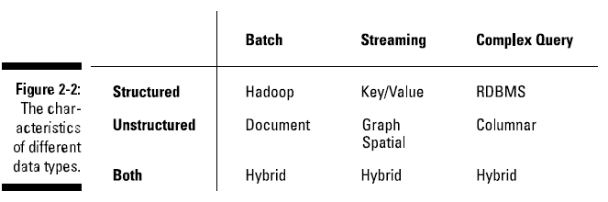
Connector -> from twitter(X) to Facebook
Meta Data -> Data about Data

Slide 16
Why we need distributed computing for big data?
Not all problems require distributed computing.
One of the perennial problems with managing data — especially large quantities of data — has been the impact of latency.
Latency is the delay within a system based on delays in execution of a task.
Distributed computing and parallel processing techniques can make a significant difference in the latency experience.
Many big data applications are dependent on low latency because of the big data requirements for speed and the volume and variety of the data.
Notes:
When you are dealing with real-time data, a high level of latency means the difference between success and failure.
Latency is an issue in every aspect of computing, including communications, data management, system performance, and more.
If a big time constraint doesn’t exist, complex processing can done via a specialized service remotely. If you have ever used a wireless phone, you have experienced latency firsthand. It is the delay in the transmissions between you and your caller.
It may not be possible to construct a big data application in a high latency environment if high performance is needed.
The need to verify the data in near real time can also be impacted by latency.

Slide 17
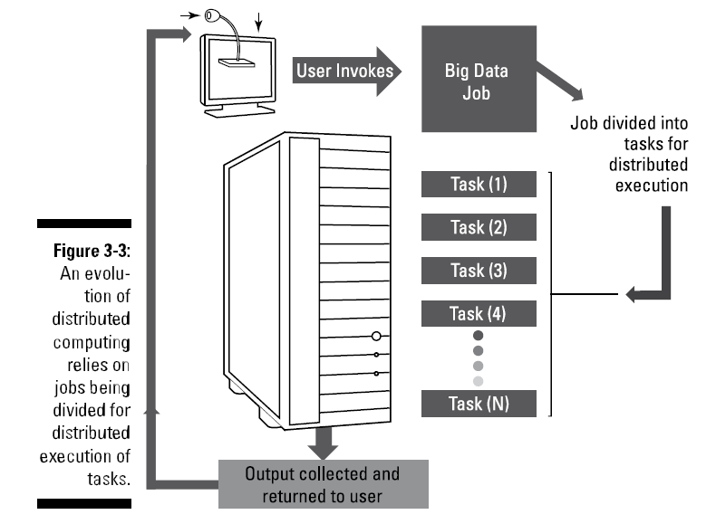
Distributed work
Distribute components of your big data service across a series of nodes.
In distributed computing, a node is an element contained within a cluster of systems or within a rack.
A node typically includes CPU, memory, and some kind of disk
Or a blade CPU and memory that rely on nearby storage within a rack.
Within a big data environment, these nodes are typically clustered together to provide scale.

Slide 18
Usage of Distributed Computing in Big Data
To accommodate the growth, an organization simply adds more nodes into a cluster so that it can scale out to accommodate growing requirements.
it is important to be able to send part of the big data analysis to different physical environments.
Where you send these tasks and how you manage them makes the difference between success and failure.
The closer together the distributions of functions are, the faster they can execute.
Therefore, scalability is the lynchpin of making big data operate successfully.
Big data requires the inclusion of fast networks and inexpensive clusters of hardware that can be combined in racks to increase performance by dynamic scaling and load balancing.
The design and implementations of MapReduce are excellent examples of how distributed computing can make big data operationally visible and affordable.
Notes:
In some complex situations, you may want to execute many different algorithms in parallel, even within the same cluster, to achieve the speed of analysis required.

Slide 19
Implementation of Big Data Architecture

Slide 20
Layer 0: Redundant Physical Infrastructure
At the lowest level of the stack is the physical infrastructure — the hardware, network, and so on.
Performance:How responsive do you need the system to be? Performance, also called latency, is often measured end to end, based on a single transaction or query request.
Availability: Do you need a 100 percent uptime guarantee of service? How long can your business wait in the case of a service interruption or failure?
Scalability: How big does your infrastructure need to be? How much disk space and computing power are needed? Decide what you need and then add a little more scale for unexpected challenges.
Flexibility: How quickly can you add more resources to the infrastructure? How quickly can your infrastructure recover from failures?
Cost: What can you afford?
As big data is all about high-velocity, high-volume, and high-data variety, the physical infrastructure will literally “make or break” the implementation.

Slide 21
Layer 1: Security Infrastructure
Data access: Most core data storage platforms have rigorous security schemes and are often augmented with a federated identity capability, providing appropriate access across the many layers of the architecture.
Application access: Application access to data is also relatively straightforward from a technical perspective. Most application programming interfaces (APIs) offer protection from unauthorized usage or access.
Data Encryption: Encrypting and decrypting data really stresses the systems’ resources. With the volume, velocity, and varieties associated with big data, this problem is exacerbated. Try to identify the data elements requiring different level of security and to encrypt only the necessary items.
Threat detection: The inclusion of mobile devices and social networks exponentially increases both the amount of data and the opportunities for security threats. It is therefore important that organizations take a multiperimeter approach to security.

Slide 22
API (Application Programming Interface)
API is the interfaces that provide bidirectional access to all the components of the stack — from corporate applications to data feeds from the Internet.
Big data challenges require a slightly different approach to API development or adoption.
A new technique, called Natural Language Processing (NLP), is emerging as the preferred method for interfacing between big data and your application programs.(Large Language Model (LLM) such as Chatgpt AI are now in popularity.)
One way to deal with interfaces is to implement a “connector” factory

Slide 23
API: Connector Factory
A “connector” factory adds a layer of abstraction and predictability to the process, and it leverages many of the lessons and techniques used in Service Oriented Architecture (SOA).
Design a set of services to gather, cleanse, transform, normalize, and store big data items in the storage system. the factory could be driven with interface descriptions written in Extensible Markup Language (XML)
This level of abstraction allows specific interfaces to be created easily and quickly without the need to build specific services for each data source.
In practice, you could create a description of SAP or Oracle application interfaces using something like XML.
Each interface would use the same underlying software to migrate data between the big data environment and the production application environment independent of the specifics of SAP or Oracle.
If you need to gather data from social sites on the Internet (such as Facebook, Google+, and so on), the practice would be identical.

Slide 24
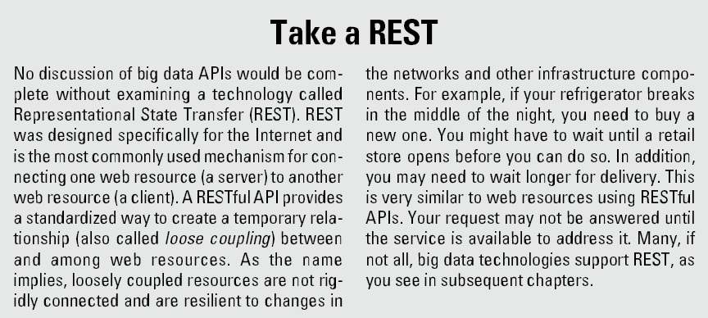
REST

Slide 25
Layer 2: Operational Databases
Relational Database’s ACID Characteristics
✓ Atomicity: A transaction is “all or nothing” when it is atomic. If any part of the transaction or the underlying system fails, the entire transaction fails.
✓ Consistency: Only transactions with valid data will be performed on the database. If the data is corrupt or improper, the transaction will not complete and the data will not be written to the database.
✓ Isolation: Multiple, simultaneous transactions will not interfere with each other. All valid transactions will execute until completed and in the
order they were submitted for processing.
✓ Durability: After the data from the transaction is written to the database, it stays there “forever.”

Slide 26
Not Only SQL Database
BASE
Basically Available
Soft State
Eventual Consistency
Distributed System
CAP Theorem

Slide 27
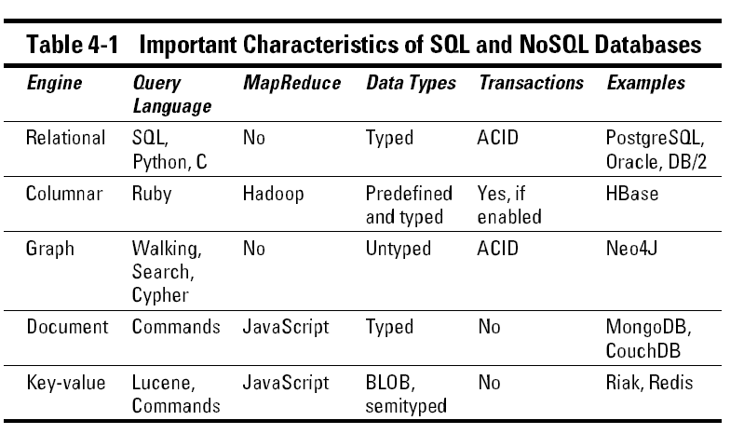
Characteristics of SQL and NoSQL databases

Slide 28
Layer 3: Organizing Data Services and Tools
Many of these organizing data services are MapReduce engines, specifically designed to optimize the organization of big data streams.
Organizing data services are, in reality, an ecosystem of tools and technologies that can be used to gather and assemble data in preparation for further processing.
✓ A distributed file system: Necessary to accommodate the decomposition of data streams and to provide scale and storage capacity
✓ Serialization services: Necessary for persistent data storage and multilanguage remote procedure calls (RPCs)
✓ Coordination services: Necessary for building distributed applications (locking and so on)
✓ Extract, transform, and load (ETL) tools: Necessary for the loading and conversion of structured and unstructured data into Big Data File System such as Hadoop
✓ Workflow services: Necessary for scheduling jobs and providing a structure for synchronizing process elements across layers

Slide 29
Layer 4: Analytical Data Warehouses/ DataLake
Data warehouses and marts simplify the creation of reports and the visualization of disparate data items. They are generally created from relational databases, multidimensional databases, flat files, and object databases — essentially any storage architecture. (Extract-Trasform-Load)
Most data warehouse implementations are kept current via batch processing.
The problem is that batch-loaded data warehouses and data marts may be insufficient for many big data applications.
The stress imposed by high-velocity data streams will likely require a more real-time approach to big data warehouses.
Data Lake is a new emerging concept for handling both Batch and Real-time Data which rely on ELT(Extract-Load-Transform)

Slide 30
Layer 5 & 6: Big Data Analytics and Visualization
Reporting and dashboards: These tools provide a “user-friendly” representation of the information from various sources. These tools now access the new kinds of databases collectively called NoSQL (Not Only SQL).
Visualization: Business users can watch the changes in the data utilizing a variety of different visualization techniques, including mind maps, heat maps, infographics, and connection diagrams. Sometimes, animation and interactive visualizations are used.
Analytics and advanced analytics: These tools reach into the data warehouse and process the data for human consumption. Advanced analytics should explicate trends or events that are transformative, unique, or revolutionary to existing business practice. Predictive analytics and sentiment analytics are good examples of this science.

Slide 31
Layer 7: Big Data Applications
These applications are either horizontal, in that they address problems that are common across industries, or vertical, in that they are intended to help solve an industry-specific problem.
Like any other custom application development initiative, the creation of big data applications will require structure, standards, rigor, and well-defined APIs.
Most business applications wanting to leverage big data will need to subscribe to APIs across the entire stack. It may be necessary to process raw data from the low-level data stores and combine the raw data with synthesized output from the warehouses.
Notes:
The most prevalent categories as of this writing(2013) are log data applications (Splunk, Loggly), ad/media applications (Bluefin, DataXu), and marketing applications (Bloomreach, Myrrix).

